Slide 1

Synthetic Controls
(Matching meets differences-in-differences)
October 24, 2024

Slide 2
Outline for today
some specification tests for matching
matching and differences-in-differences
bounds
(all of the above come from the previous slides)
synthetic controls

Slide 3
What we’ve seen so far…
Matching can work when you have many control and treatment observations, with overlapping characteristics
Particularly if you can afford to throw away (or downweight) data
What if you have few (one!) treatment unit, and only a handful of controls?
and/or maybe if this is a ‘large’ treatment that may have substantial effects throughout the ‘treatment’ region
But in return, you have lots of observations over time for each of these?
e.g. 1: Effect of terrorism in the Basque region of Spain on economic activity (Abadie and Gardeazabal 2003)
e.g. 2: Effect of legislation on cigarette sales in California (Abadie, Diamond and Hainmueller 2010)

Slide 4
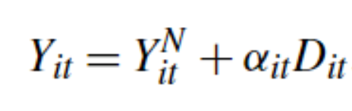
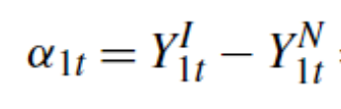
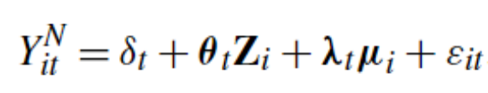
In general…
time | D1 | outcome for i=1 | outcome for j=2 | outcome for j=3
1 | 0 | y11 | y21 | y31
2 | 0 | y12 | y22 | y32
3 | 0 | y13 | y23 | y33
4 | 0 | y14 | y24 | y34
5 | 0 | y15 | y25 | y35
(T0) 6 | 1 | y16 | y26 | y36
7 | 1 | y17 | y27 | y37
8 | 1 | y18 | y28 | y38
9 | 1 | y19 | y29 | y39
Let Y_{it} be the outcome of region i in time t
Y_{it}^{N} is what would have happened in absence of the treatment and D_{it} is a dummy variable for treatment
we want to estimate for t > T₀
to do this, we only need to estimate Y_{it}^{N}

Slide 5
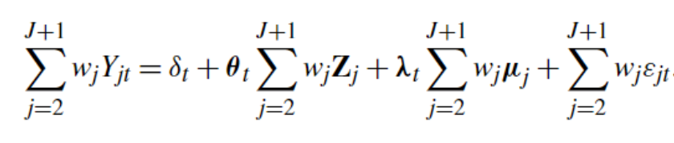
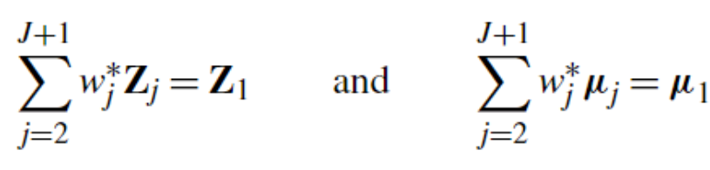
those same parameters also are assumed to hold for the controls
consider a set of weights ‘wj’:
we want those weights to fit:
but we don’t observe μ. However, under most conditions, if the weights fit both Z₁ and Y_{1t-s}, they will fit μ₁.

Slide 6
California Prop 99

Slide 7
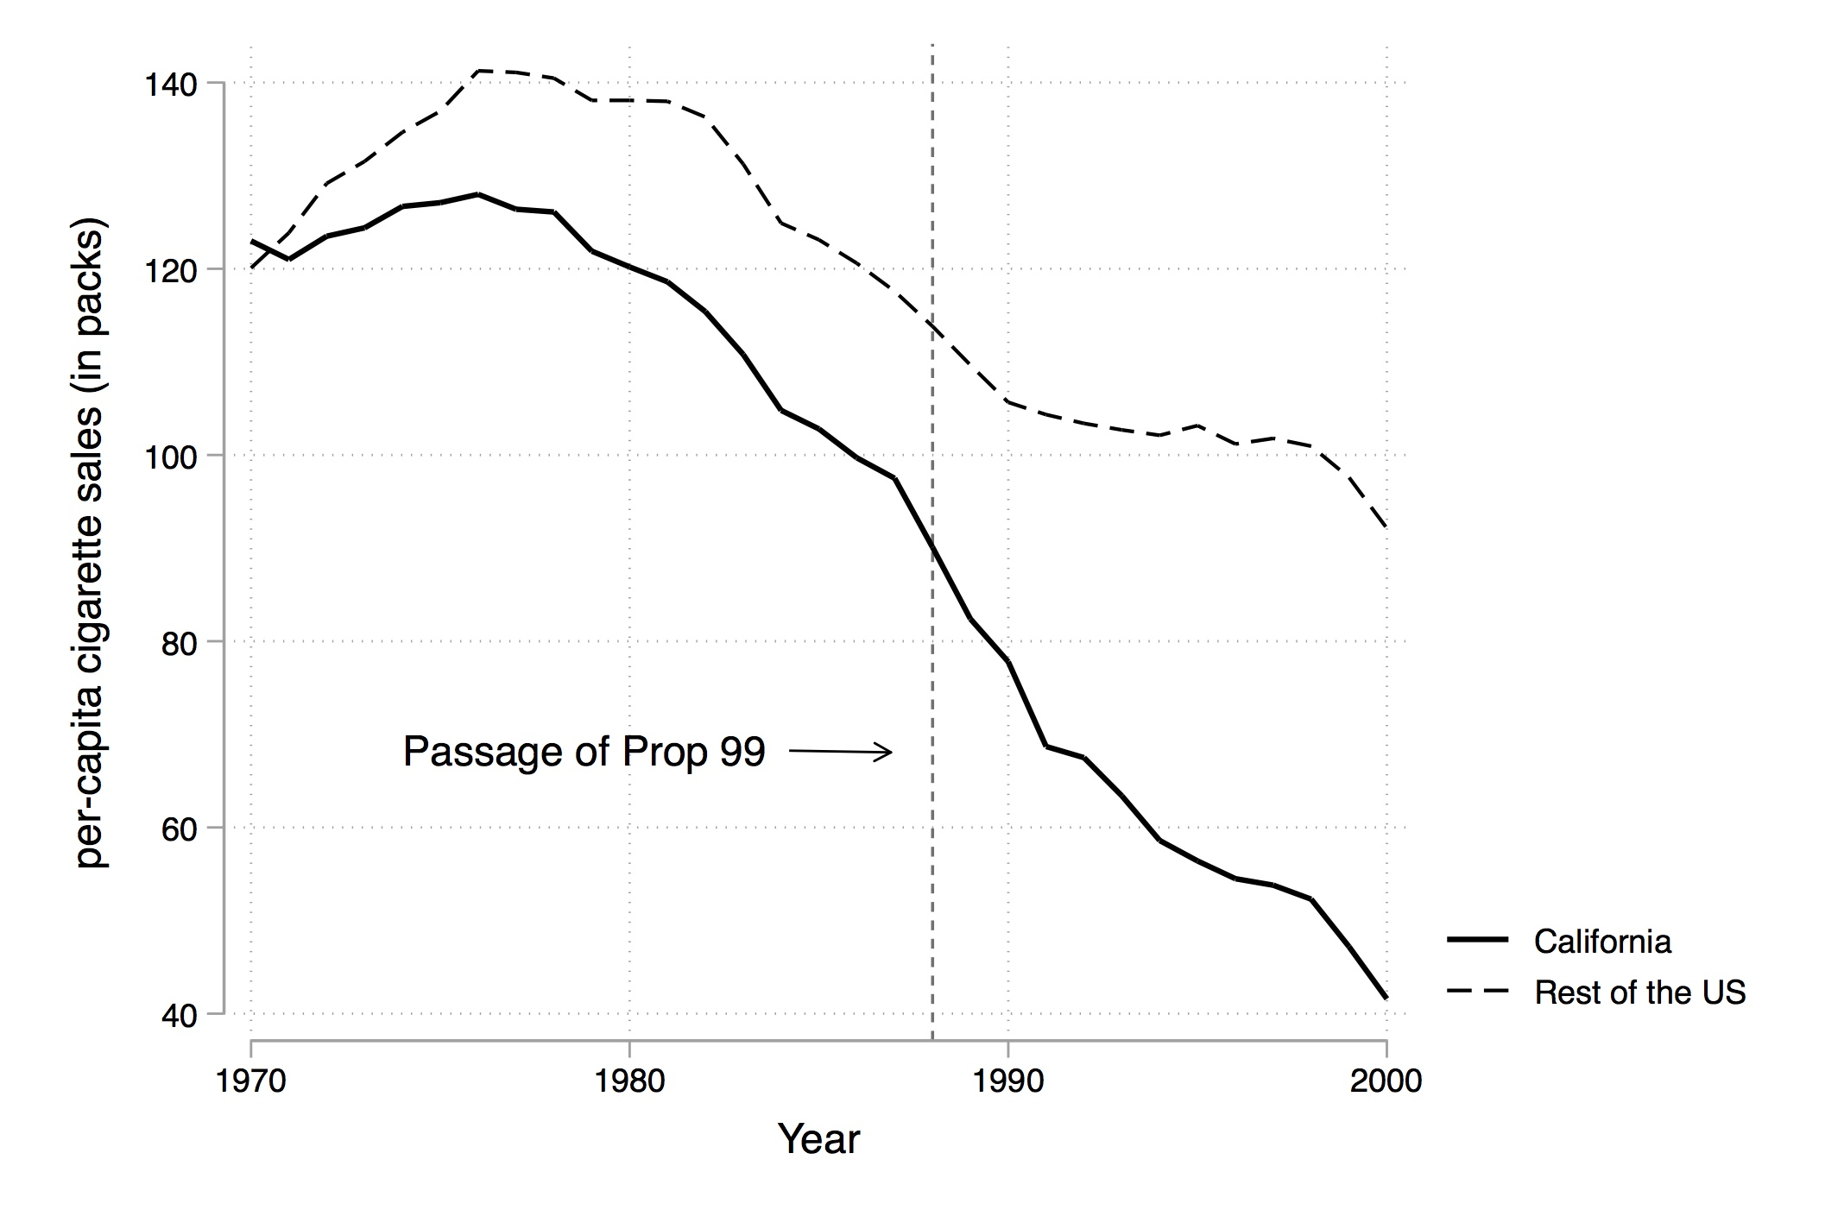

Slide 8
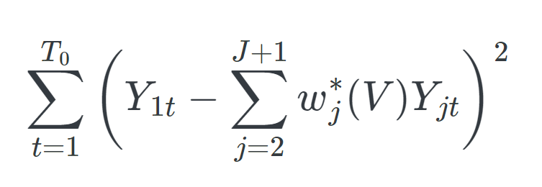
How to create a “Synthetic California”
Pick a group of potential control states (called the ‘donor pool’), denoted as j=2…N
estimate weights on those other states and on their covariates to match pre-treatment observed outcomes in California (rule out negative weights). Pick weights to minimize:
where V is a matrix of (time-invariant) weights on the characteristics (or features) of each observation

Slide 9
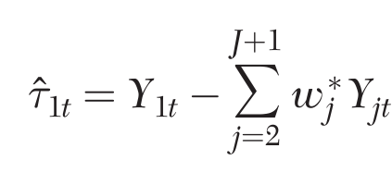
Treatment effect
The treatment effect is then estimated to be the difference between the outcome in the treated unit and the outcome of the synthetic control after treatment

Slide 10
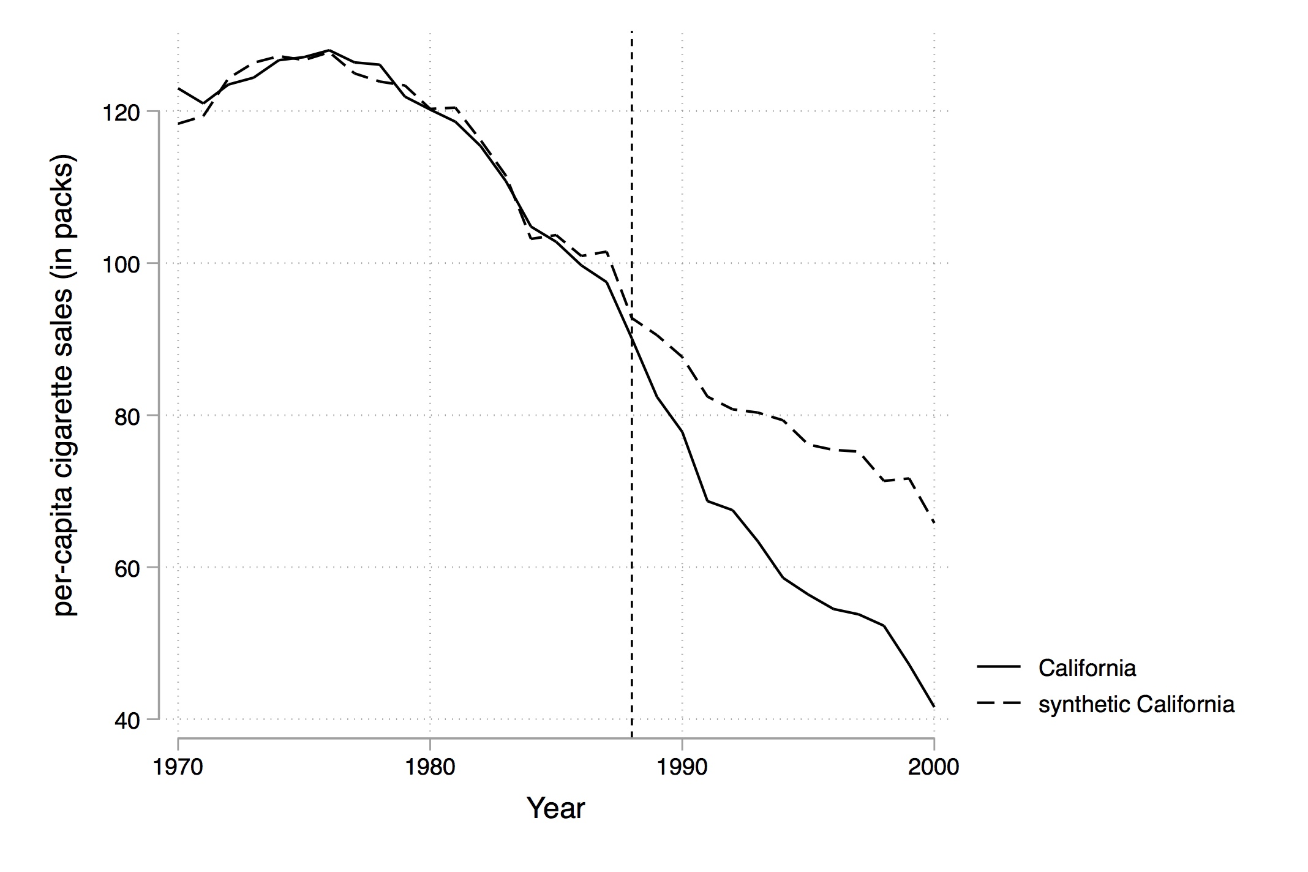

Slide 11
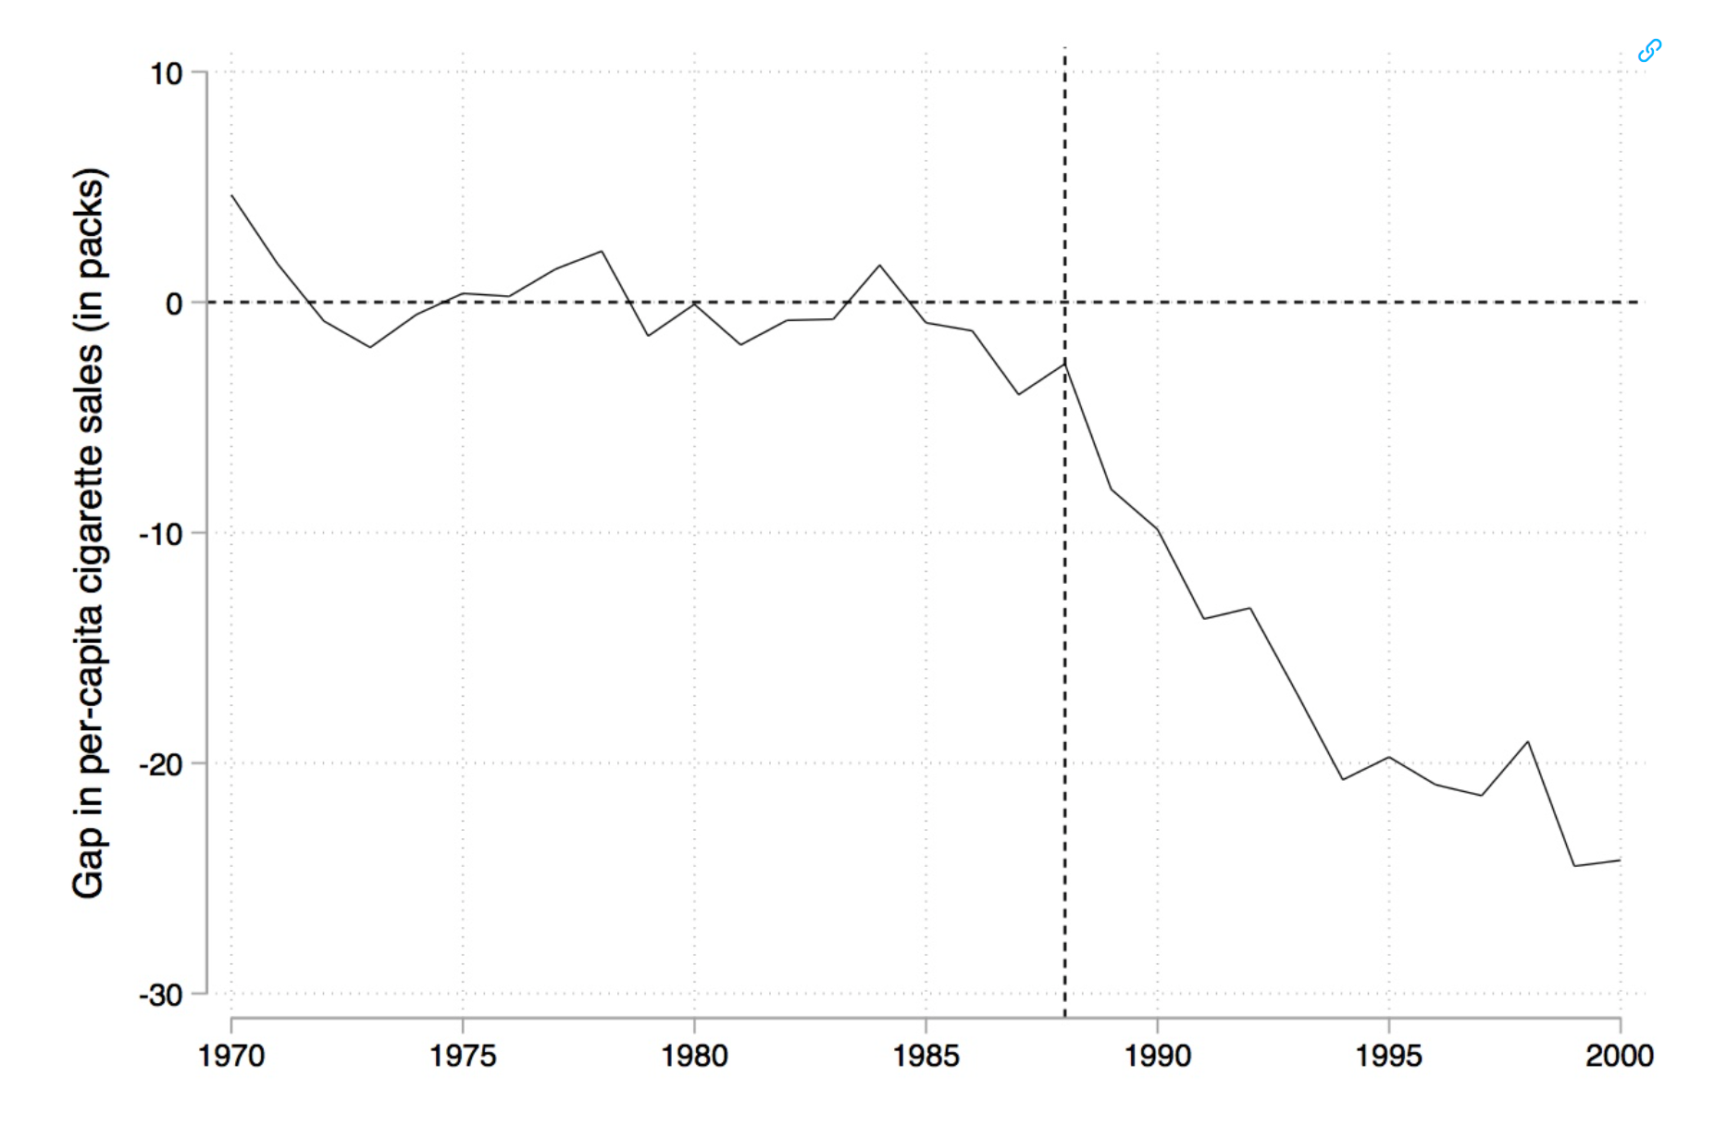

Slide 12
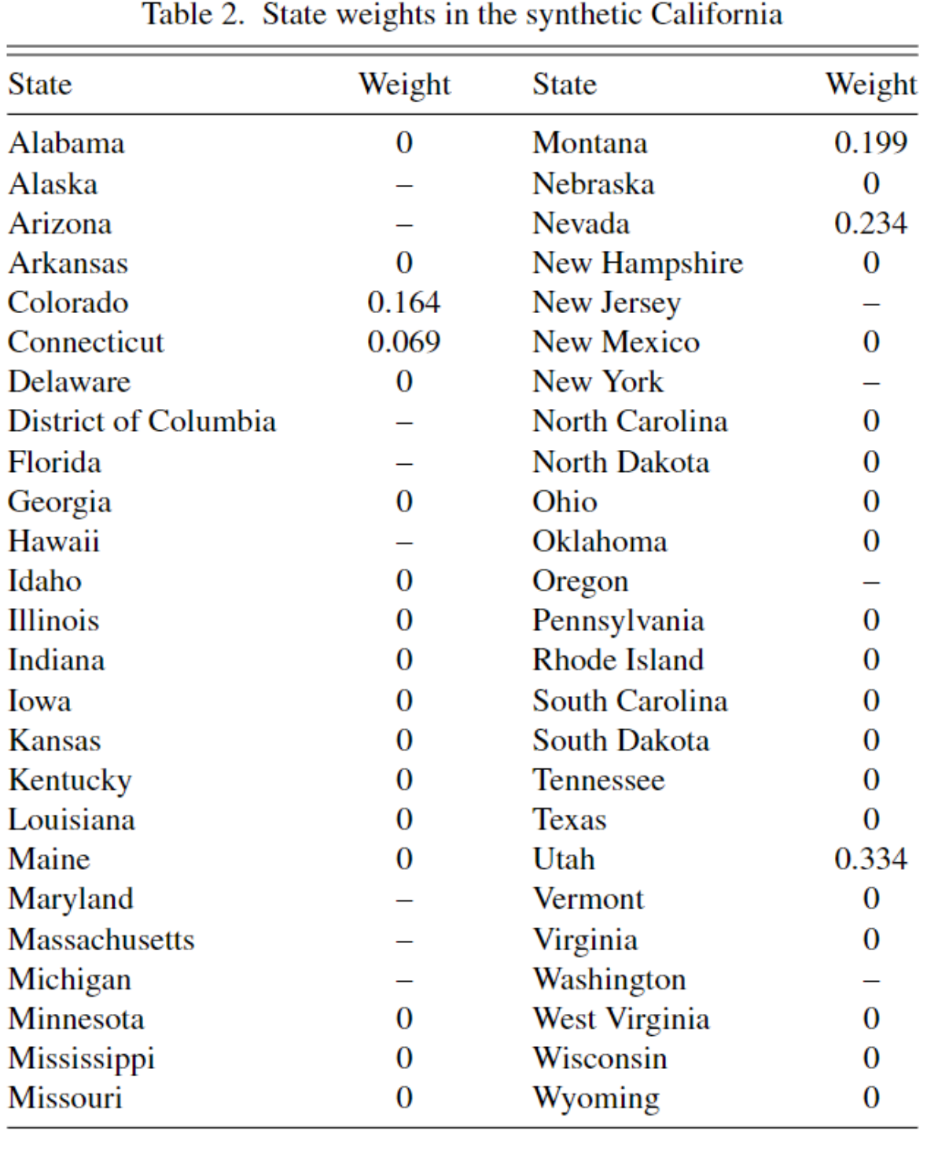
their estimated weights

Slide 13
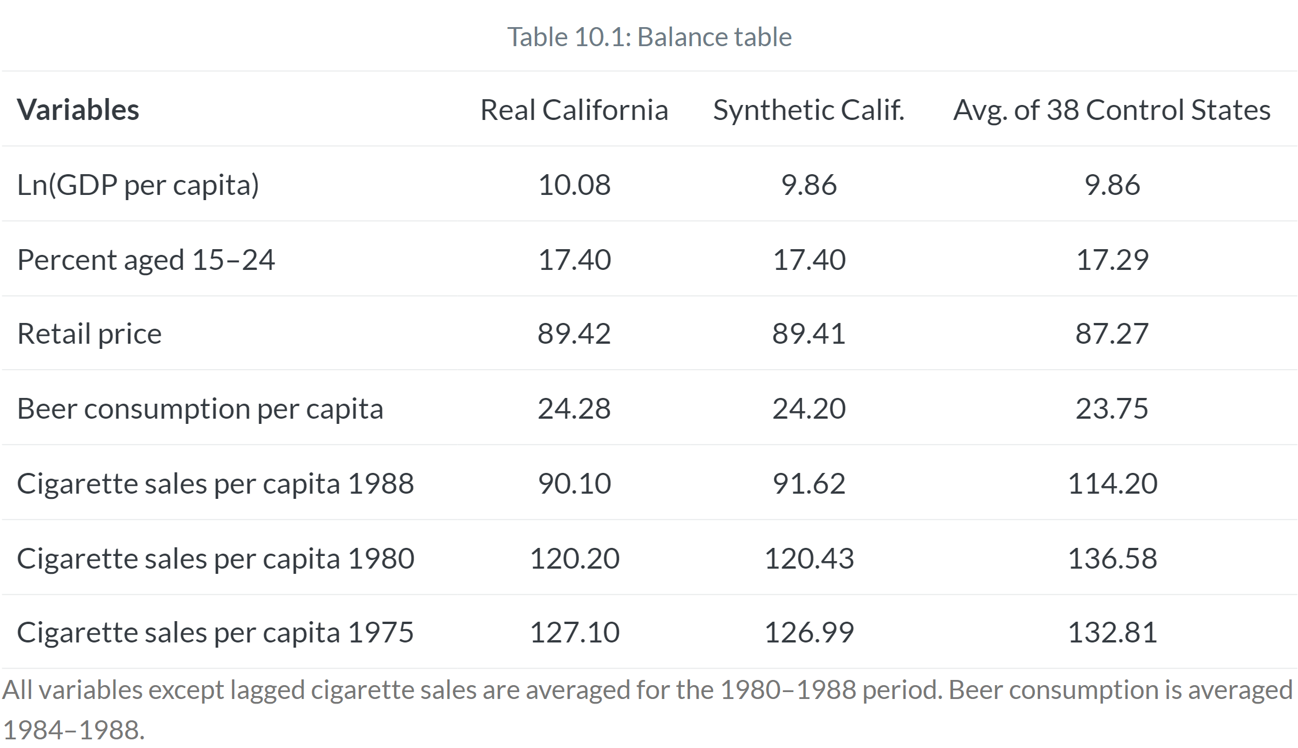

Slide 14
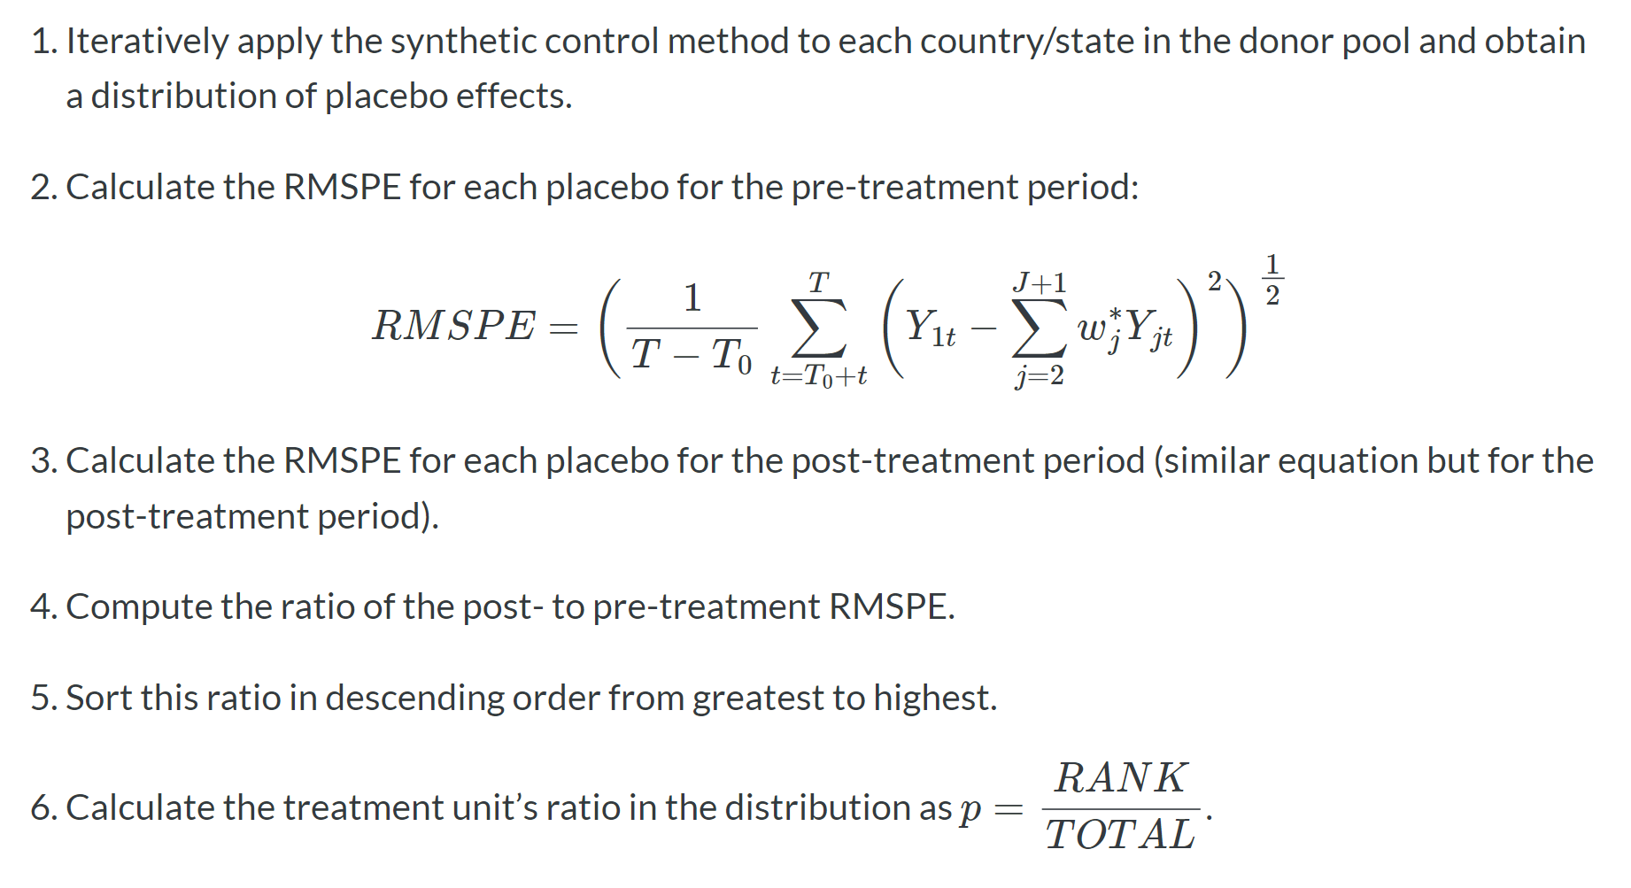
How to calculate significance?

Slide 15
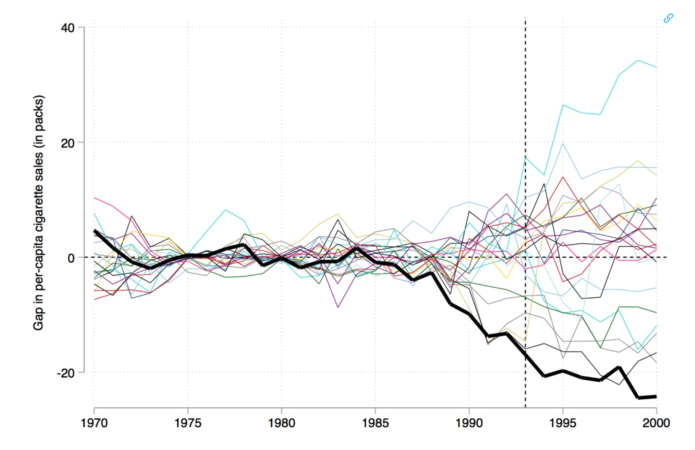

Slide 16
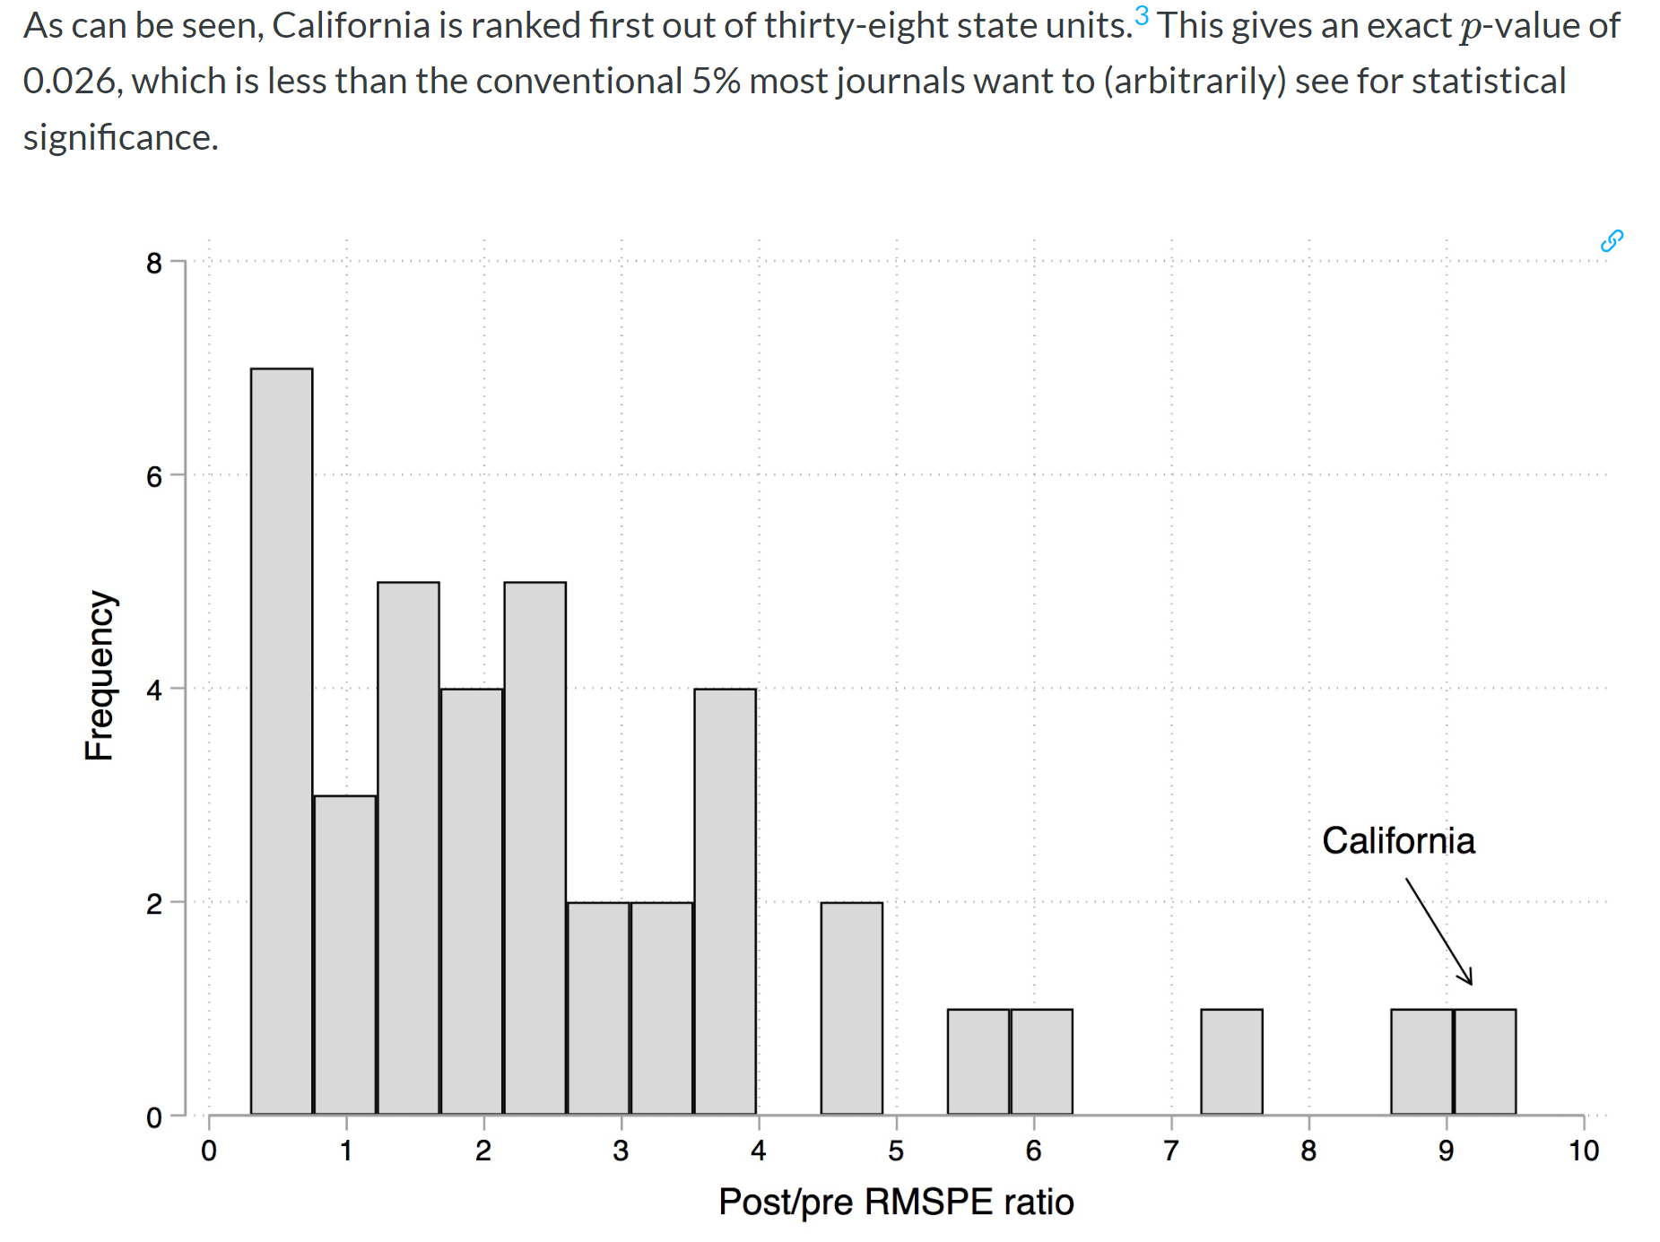

Slide 17
Why it’s kind of cool…
It precludes extrapolation beyond the data support (which can happen in regressions)
Using our example from last class, imagine our control observations are all lower elevation and we use them to estimate the marginal effect of potential yield on deforestation. We may be extrapolating that relationship into our treatment.
Can generate the control all based on pre-treatment outcomes (no need to know (or peek at) post-treatment outcomes
weights are transparent

Slide 18
What you can do to test your model
balance test on other unrelated outcomes
run placebo tests for t-n (i.e. look for a difference before ‘treatment’)

Slide 19
References
Cunningham, Scott. Causal Inference: the mixtape https://mixtape.scunning.com/10-synthetic_control
Abadie, Alberto. 2021. “Using Synthetic Controls: Feasibility, Data Requirements, and Methodological Aspects.” Journal of Economic Literature 59 (2).
Abadie, Alberto, and Javier Gardeazabal. 2003. “The Economic Costs of Conflict: A Case Study of the Basque Country.” American Economic Review 93 (1): 113–32.
Abadie, Alberto, Alexis Diamond, and Jens Hainmueller. 2010. “Synthetic Control Methods for Comparative Case Studies: Estimating the Effect of California’s Tobacco Control Program.” Journal of the American Statistical Association 105 (490): 493–505.
Ferman, Bruno, Cristine Pinto, and Vitor Possebom. 2020. “Cherry Picking with Synthetic Controls.” Journal of Policy Analysis and Management
Finkelstein, Amy, Sarah Taubman, Bill Wright, Mira Bernstein, Jonathan Gruber, Joseph P. Newhouse, Heidi Allen, and Katherine Baicker. 2012. “The Oregon Health Insurance Experiment: Evidence from the First Year.” Quarterly Journal of Economics 127 (3): 1057–1106. (Just for your possible interest: Oregon health lottery paper)

